Slide 1
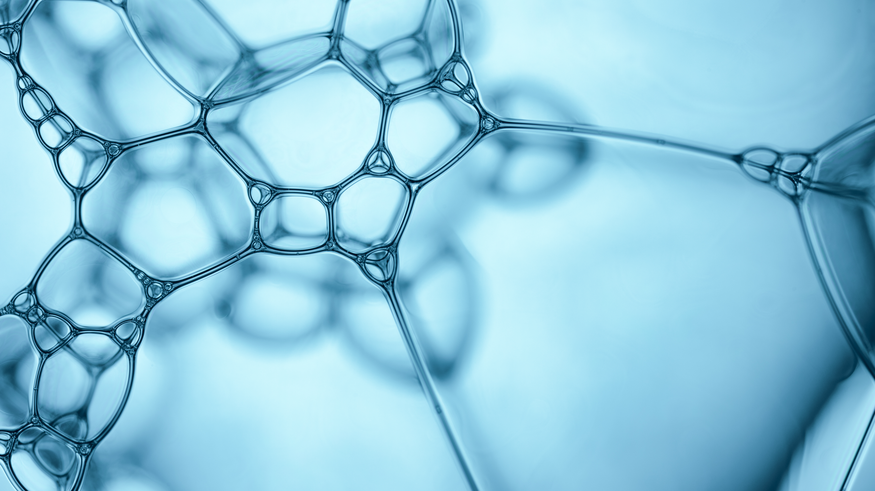
Medical Image Classification with Deep Learning
V S Sanjay Babu
V Dharshini
A Ashwini

Slide 2
Techniques Used In Medical Analysis
Artificial Intelligence
Deep Learning
Machine Learning

Slide 3
Use of AI in Medical Analysis
The use of artificial intelligence (AI) in diagnostic medical imaging is undergoing extensive evaluation.
AI has shown impressive accuracy and sensitivity in the identification of imaging abnormalities and promises to enhance tissue-based detection and characterization.

Slide 4
Use of Machine Learning in Medical Analysis
In the healthcare setting machine learning can be used to help diagnose disease.
For Example Breast Cancer

Slide 5
In Medical Analysis ….
Deep Learning Approach (DLA) in medical image analysis emerges as a fast-growing research field.
DLA has been widely used in medical imaging to detect the presence or absence of the disease.
Most of the DLA implementations concentrate on the X-ray images, computerized tomography, mammography images, and digital histopathology images.

Slide 6
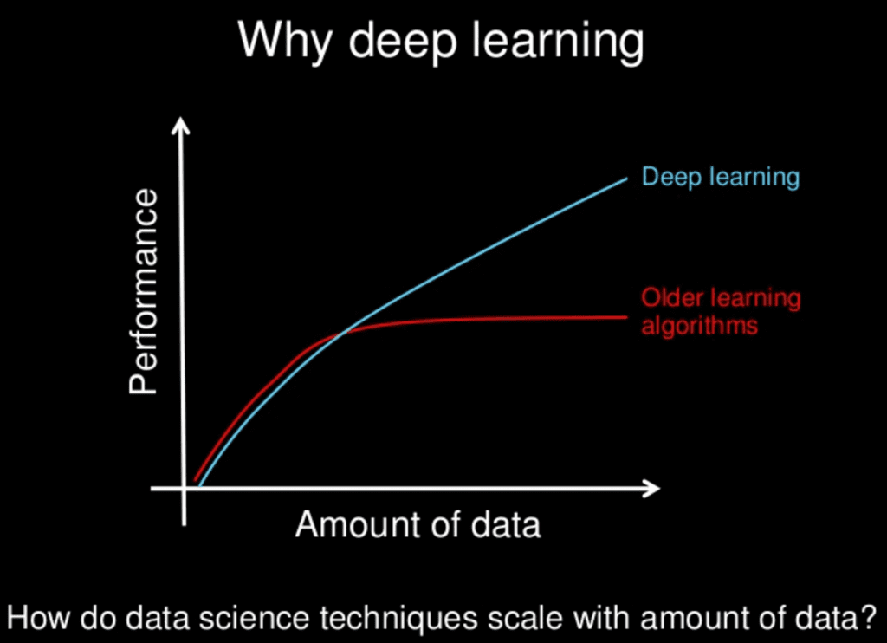
Why Deep Learning is Picking up ?

Slide 7
Why Medical Diagnosis ?

Slide 8
Artificial Neural Networks (ANN)
Artificial neural networks (ANNs) or simulated neural networks (SNNs), are a subset of Machine Learning and are at the heart of deep learning algorithms.
Artificial Neural Networks (ANN) form the basis for most of the Deep Learning Approach (DLA).
ANN is a computational model structure that has some performance characteristics similar to biological neural networks

Slide 9
Convolutional neural networks (CNN)
In neural networks, CNN is a unique family of deep learning models.
CNN is a major artificial visual network for the identification of medical image patterns.
The CNN is a method for reducing the number of parameters, allows a network to be deeper with fewer parameters.
The essential element of CNN is the handling of unstructured data through the convolution operation.

Slide 10
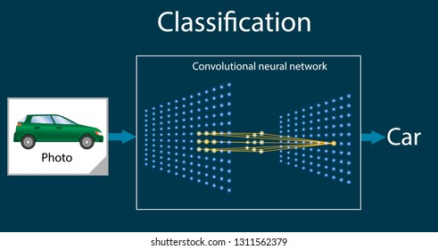
How CNN works ?

Slide 11
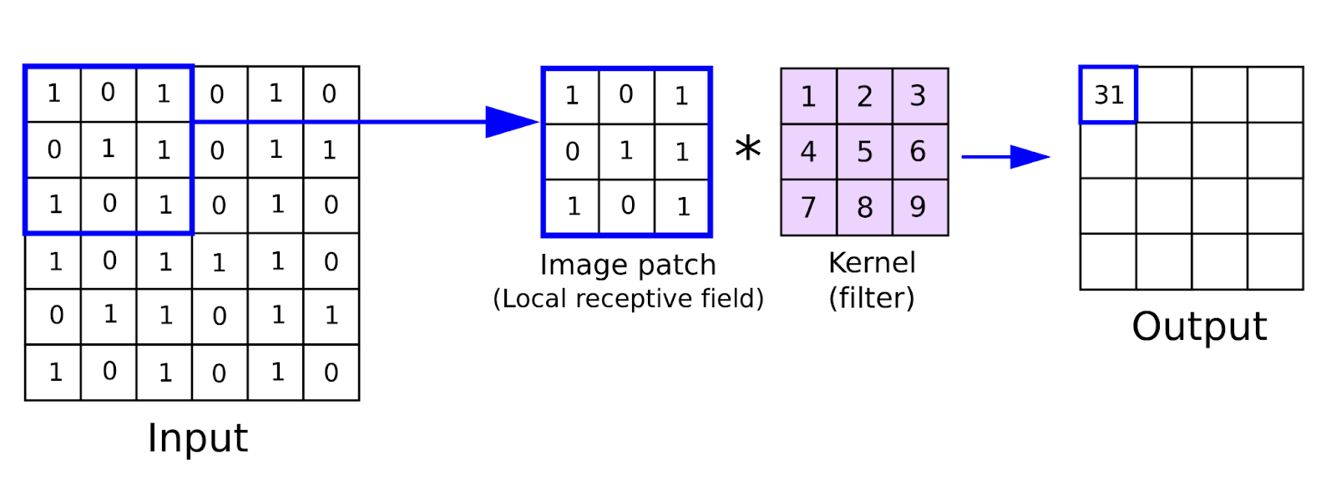
Mathematically represented as,

Slide 12
U - Net
Ronneberger proposed CNN-based U-Net architecture for segmentation in biomedical image data.
The architecture consists of a contracting path (left side) to capture context and an expansive symmetric path (right side) that enables precise localization.
U-Net is a generalized DLA used for quantification tasks such as cell detection and shape measurement in medical image data.

Slide 13

U - Net

Slide 14
Thank You

